Slide 1
Sorting, searching
Algorithm analysis
Life Choices Coding Academy 2020

Slide 2
Learning outcome:
By the end of this section, student should be able to:
Understand why they need to know the basics regarding algorithms.
Know how to implement certain sorting algorithms.
Know how to implement certain searching algorithms.
Notes:
https://www.quora.com/What-is-the-fastest-sorting-algorithm?share=1

Slide 3
Today’s topics:
Searching
Linear Search
Binary Search
Sorting
Selection Sort
Insertion Sort
Merge Sort
Quick Sort
Notes:
https://www.quora.com/What-is-the-fastest-sorting-algorithm?share=1
Start off by asking if there is anyone who knows the fastest searching or sorting algorith.

Slide 4
Searching
In programming, we search in a data structure because we are looking for something.
Depending on how data is organized, we can search in different ways.
If your data is organised in some way, we can do more efficient searches.
Notes:
We frequently search for strings in things like web pages, PDF, documents, etc.
For organised data, we usually have to do a linear search, which is the first type of search we will discuss.
You arrive at a new company for an internship, you in the Kitchen, trying to get some coffee, cool. There are five drawers and you
Need a spoon. Which drawer are going to start with, and why?
If our data is in strict order, we can perform a binary search, which is second type of search we will look at.
The house is organised, right? How often do you search for cutlery in your bedroom?

Slide 5
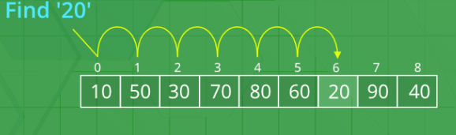
Linear Search
The most straightforward type of a search is the linear search.
We traverse the data structure (e.g., a string’s characters, or a list) until we find the result.
Below is how to do a linear search….
Notes:
Let’s say we are looking for 20.
Anyone have a clue why do we have to start at index zero?
Because we do not know anything about the contents in the list.
Let’s see how can we write a linear search in python.

Slide 6
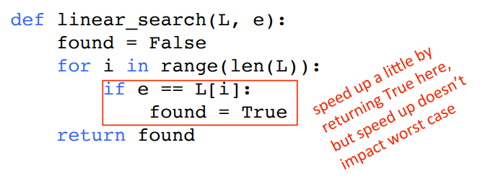
Linear Search
Must loop through all elements to decide if its not there
O(len(L)) for the loop * O(1) to test if e == L[i]
Overall complexity is O(n) where n is len(N)
Notes:
Demonstrate what the reed text means.
This is a linear search (Brute force) - Explain brute force and other algorithm types while your’re here.
Recursive algorithms.
Dynamic programming algorithm.
Backtracking algorithm.
Divide and conquer algorithm.
Greedy algorithm.
Brute Force algorithm.
Randomized algorithm.

Slide 7
Binary Search
Linear search is slow! Why?
We can drastically speed up our searches if we first sort our data structure.
What is the best strategy for the guess my number game?
Notes:
Think of a program where a user has to guess a number between 1 and 100.
The game goes like this:
First, guess the number in the middle.
If the guess is too low, guess the number between the middle and the top, or the middle and the bottom.
Keep narrowing by finding the "next middle" until you win
If the list is sorted then, using binary search will be the fastest. But you see now, we know a lil bit about the list.(sorted).

Slide 8
Search Algorithms
Demo Binary Search
Notes:
Anyone know the name of google search algorithm?
def binary_search(sorted_list, value_to_find):
"""
Performs a binary search on sorted_list for value_to_find
:param sorted_list: a sorted list, smallest to largest
:param value_to_find: the value we are looking for
:return: the index of value_to_find, or -1 if not found
"""
low = 0 # the low index
high = len(sorted_list) - 1 # the high index
while low <= high:
mid = (low + high) // 2 # the middle value
if sorted_list[mid] < value_to_find:
low = mid + 1
elif sorted_list[mid] > value_to_find:
high = mid - 1
else: # found!
return mid
return -1
https://slides.com/tofergregg/cs5001-10-searching-sorting#/11

Slide 9

Sorting Algorithms
In general, sorting consists of putting elements into a particular order.
Most often the order is either numeric or alphabetic.
It’s a well-researched subject, although new algorithms do arise sometimes.
Notes:
(see Timsort, from 2002), which is the latest discovered. Explore link below. Google chrome v8 engine uses timsort for their sort function. It will be cool to know how it works :)
https://en.wikipedia.org/wiki/Timsort
https://v8.dev/blog/array-sort
https://www.quora.com/What-is-the-fastest-sorting-algorithm?share=1

Slide 10
Sorting Algorithms
There are phenomenal online sorting demonstrations out there: see the “Sorting Algorithm Animation” website.
https://www.toptal.com/developers/sorting-algorithms
https://www.cs.usfca.edu/~galles/visualization/ComparisonSort.html
Notes:
Play selection sort animations and highlight the differences with the other sorting algorithm.

Slide 11
Sorting Algorithms
There are many, many different ways to sort elements in a list, such as Insertion sort, quicksort, selection sort, merge sort
We will look at the following for now:
- Insertion Sort
- Selection Sort
Notes:
For more information and to have an overview, you can visit the link below.
https://en.wikipedia.org/wiki/Sorting_algorithm

Slide 12
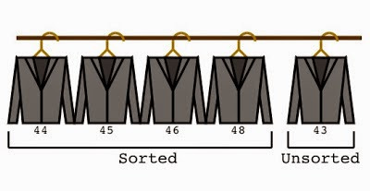
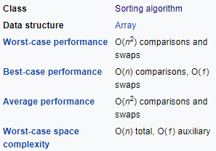
Insertion Sort
Orders a list of values by repetitively inserting a particular value into a sorted subset of the list.
Notes:
https://en.wikipedia.org/wiki/Insertion_sort
For visuals: https://www.toptal.com/developers/sorting-algorithms or https://www.cs.usfca.edu/~galles/visualization/ComparisonSort.html
Explain the tailors picture:
Real world example of insertion sort is how tailors arrange shirts in a cupboard, they always keep them in sorted order of size and thus insert new shirt at the right position very quickly by moving other shirts forward to keep the right place for a new shirt.
Demonstrate insertion sort in class :) and the complexity….

Slide 13
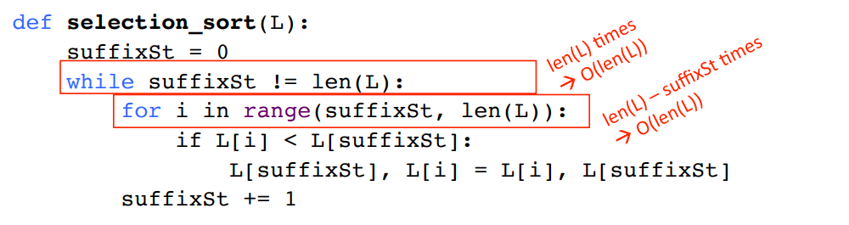
Selection Sort
Outer loop executes len(L) times
Inner loop executes len(L) - i times
Complexity of selection sort is O(n^2) where n is len(L)
Notes:
Real life usage: Picking apples and placing them in order.
Think of a packaging industry (apples?), they get all different sizes on the conveyor belt but they manage to sort them into small, medium and large.

Slide 14
Thanks

Slide 15
Exercise time

